Slide 1
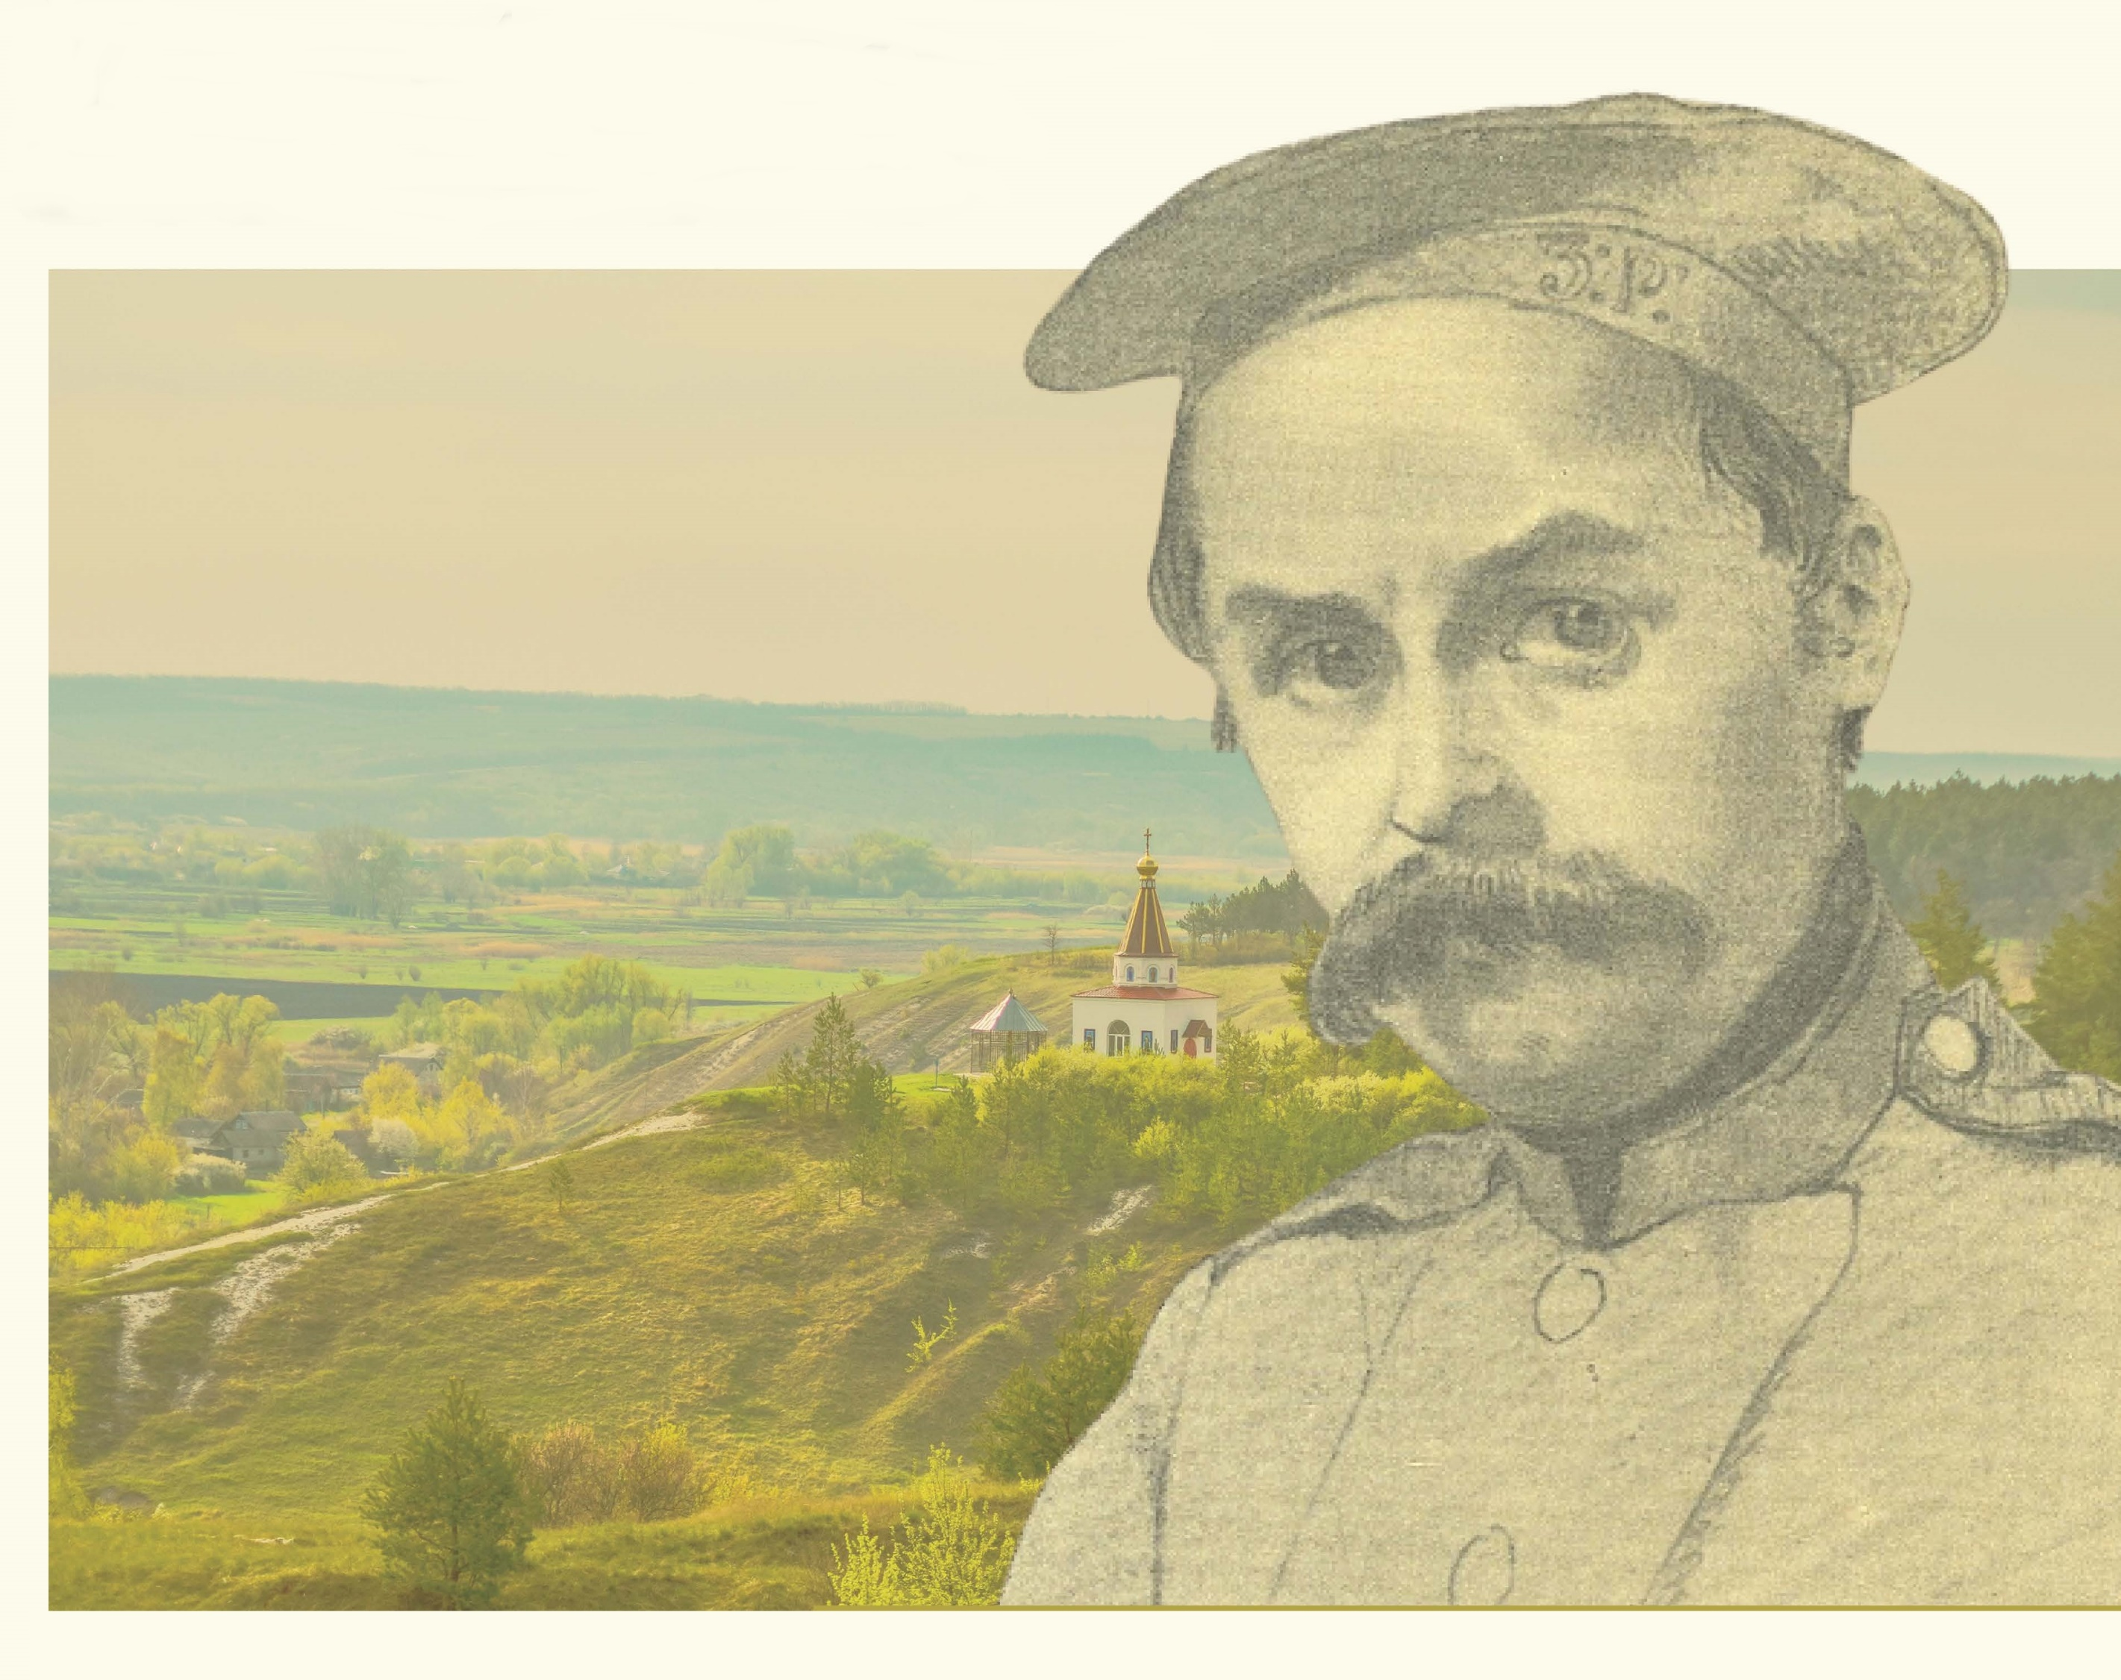
Taras and Maxim
Digging the Well

Slide 2
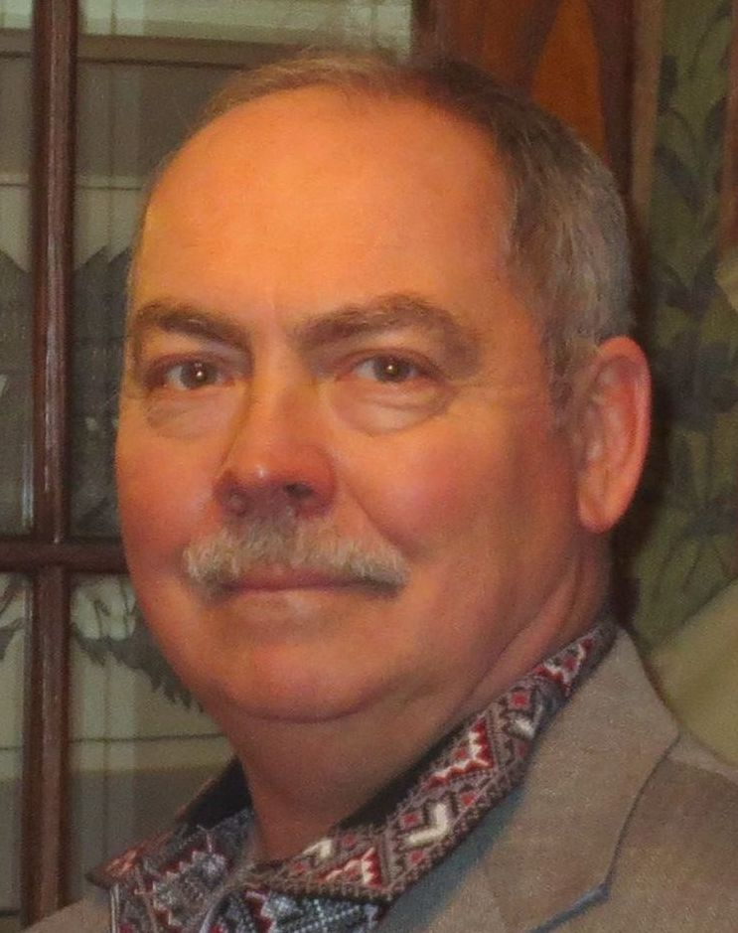
Taras and Maxim

Slide 3
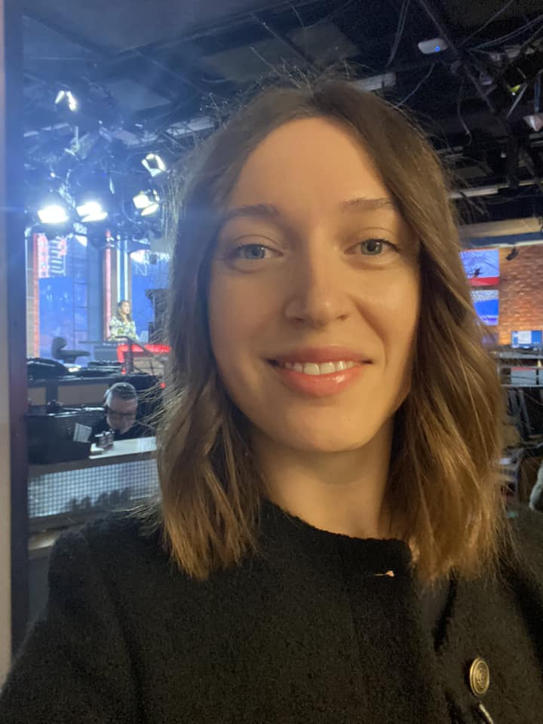
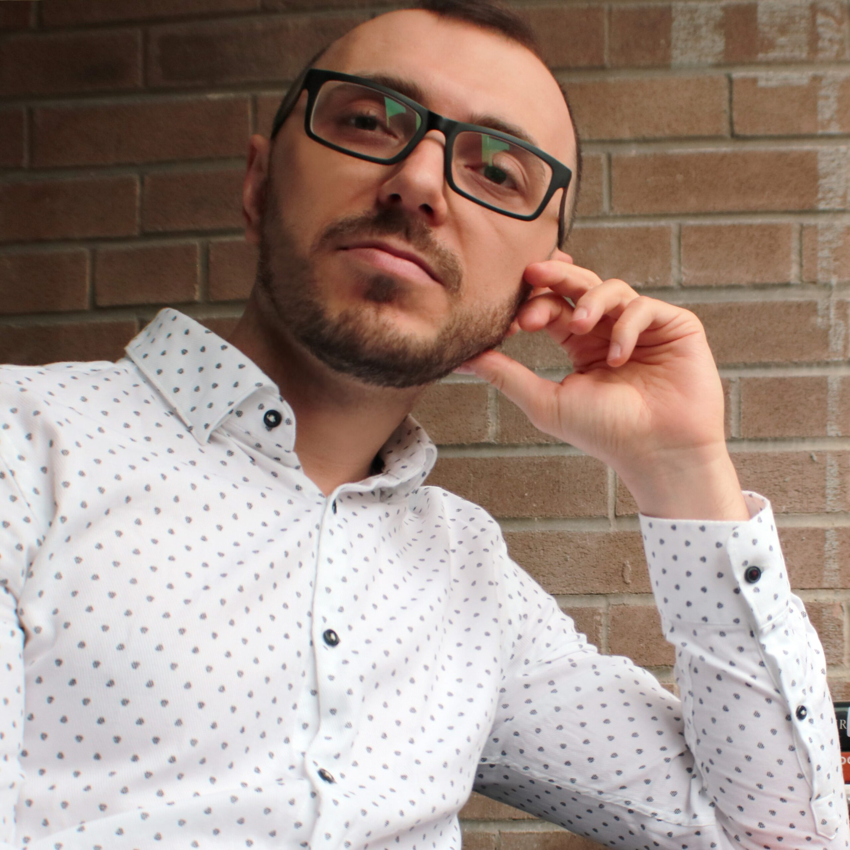
Olha Khometa Alex Averbuch

Slide 4
Lecture Outline
The word “Moskal”
Kateryna
Two modalities, two voices, two personas.
Rubchak
Grabowicz
Leonid Pliushch
Dumy moi
Poems
A numo znovu virshuvat’
Moskaleva krynytsia 1
Varnak
Moskaleva krynytsia 2

Slide 5
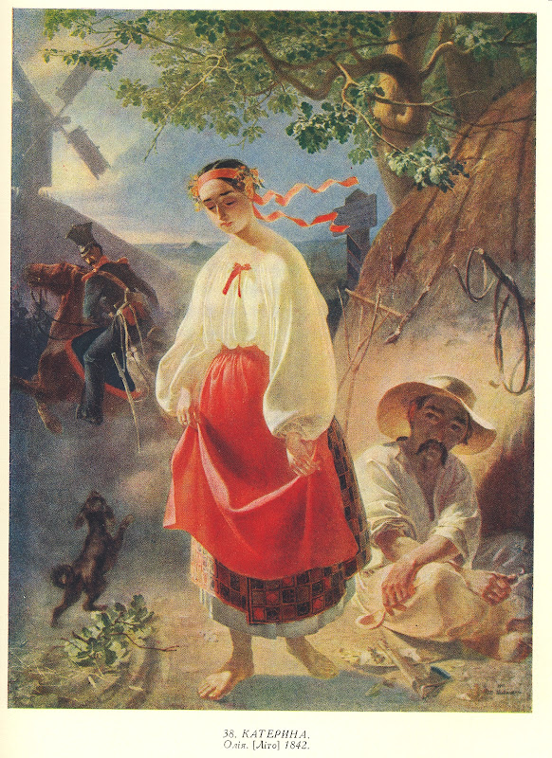
Кохайтеся, чорнобриві, Та не з москалями, Бо москалі — чужі люде, Роблять лихо з вами.
My dark-browed beauties, fall in love,
But love no Muscovite,
For Moscow troopers aliens are,
And court in your despite.
Fall in love, you dark-browed girls,
But not with Muscovites.
For Muscovites are strangers,
They will do you wrong.

Slide 6
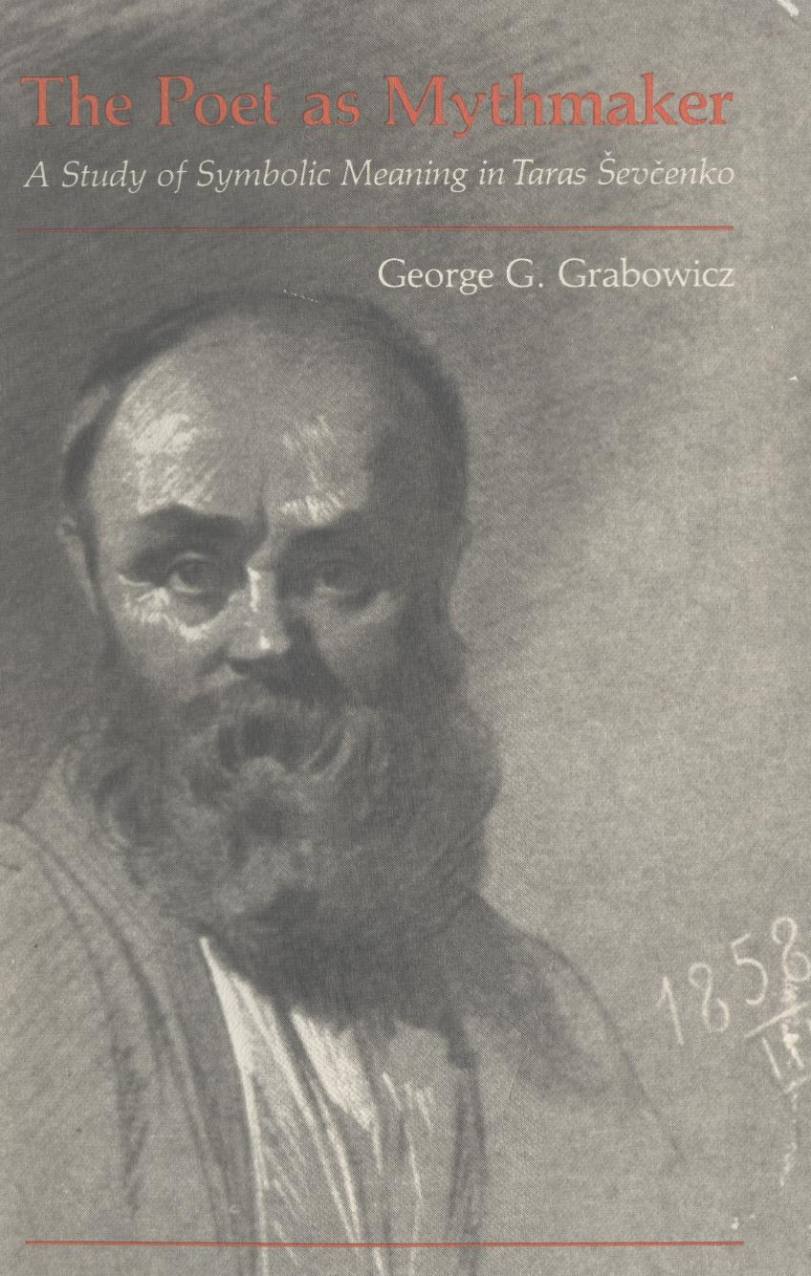

Slide 7
3 Scholars on Shevchenko’s duality
George Grabowicz, Poet as Mythmaker, 1982
Bohdan Rubchak, “Shevchenko's Profiles and Masks: The Ironic Roles of the Self in the Poetry of Kobzar.” Shevchenko and the Critics 1861–1980, 1980
Leonid Pliushch, Ekzod Tarasa Shevchenka: Navkola Moslkalevoi krynyci, 1986

Slide 8
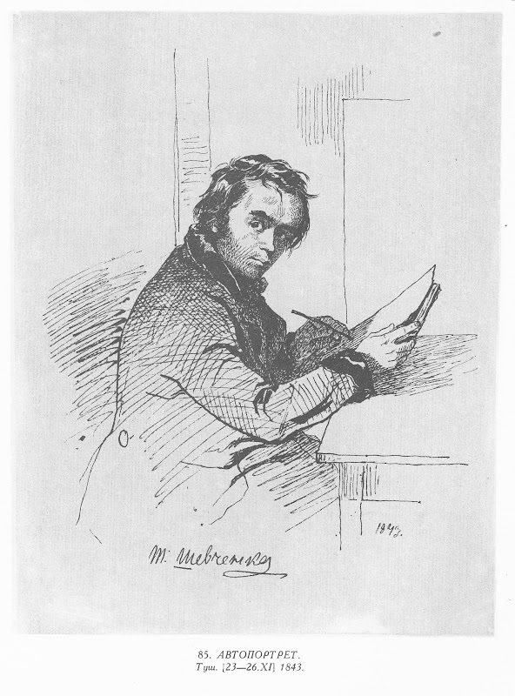
My thoughts, my thoughts,
Troubled is my life with you!
Why’ve you stood on paper
In a sad array?..
Why’s the wind not scattered you
Like dust across the steppe?
Why’s trouble not consoled you
As it would its child?..
For trouble has, as if by jest,
Brought you here into this world,
Tears have watered you…
Why did they not engulf you,
Not sweep you out to sea,
Or wash you far afield?
People would not ask what hurts,
Nor why I curse my fate,
Or why I roam the world? “Doing nothing” —
They’d not say derisively.
Думи мої, думи мої,
Лихо мені з вами!
Нащо стали на папері
Сумними рядами?..
Чом вас вітер не розвіяв
В степу, як пилину?
Чом вас лихо не приспало,
Як свою дитину?..
Бо вас лихо на світ на сміх породило,
Поливали сльози... Чом не затопили,
Не винесли в море, не розмили в полі?
Не питали б люди, що в мене болить,
Не питали б, за що проклинаю долю,
Чого нужу світом? «Нічого робить», —
Не сказали б на сміх...

Slide 9
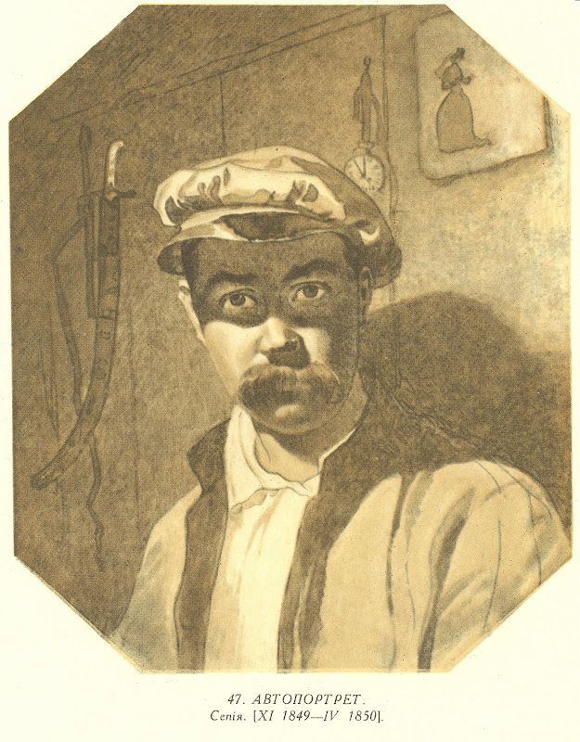
Москалева криниця
— Не варт, єй-богу, жить на світі!..
— То йди топись! — А жінка! Діти?
— Ото ж то, бачиш, не бреши!
А сядь лишень та напиши
Оцю бувальщину... То, може,
Інако скажете, небоже.
Пиши отак: було
Село.
Та щоб не лізти на чужину,
Пиши: у нас на Україні.

Slide 11
Come on, let’s write some poems again.
Secretly, of course. Come on,
While something novel forms a basis,
Let’s refurbish God’s old tale.
Or… how to tell you,
Without lying. Let’s again
Curse fate and people.
People, so they’ll show respect
And know us.
Fate, so she won’t slumber,
So she may take good care of us.
But you see the fix she’s put us in:
Indifferently, she left a child
At a crossroads,
And he’s poor, young

Slide 12
But with whitened whiskers, —
Just a kid, of course, —
And he softly hobbled off
To live beneath a foreign fence
Far beyond the Urals.
He found himself amid a desert,
He found himself in bondage…
How, cruel fate, can one not curse you?
I won’t curse you, fate,
Instead I’ll hide behind the ramparts.
And I’ll secretly write poems,
I’ll roam the world,
And I’ll expect you, my fate,
As a guest in bondage
From beyond the mighty Dnipro!

Slide 13
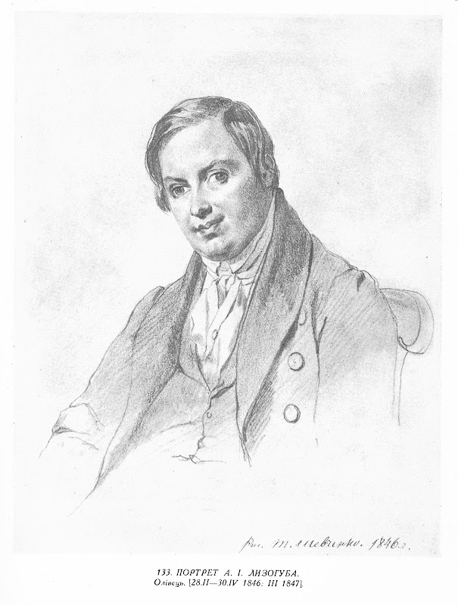
Letter to A. Lyzohub. Oct 22, 1847. Orsk fortress
На другий день, як я од вас поїхав, мене арестовали в Києві, на десятий — посадили в каземат в Петерб[урзі], а через три місяці я опинився в Орской крепости в салдатській сірій шинелі, чи не диво, скажете! Отже воно так. І я тепер точнісінький, як той москаль, що змальовав Кузьма Трохимович (Основ’яненко. “Салдацький партрет”) панові... От вам і кобзар! позабирав грошики та й шморгнув за Урал до киргиза гуляти. Гуляю! бодай нікому не довелося так гуляти, а що маємо робить! Треба хилитися, куда нагинає доля.
On the second day after I left you, I was arrested in Kyiv, on the tenth I was put in a prison cell in St. Petersburg, and three months later I found myself in the Orsk fortress in a soldier's gray overcoat. A great wonder, you might say! But it is so. And now I am precisely like that Moskal that Kuzma Trochymovych (painter in Kvitka Osnovianenko’s story, “The Soldier’s Portrait”) drew for the gentleman... There’s a kobzar for you! — took the money and ran off across the Urals to have some fun with the Kyrgyz people. Having fun, indeed! may no one ever have this much fun! But what can you do? Bend in the direction fate pushes.

Slide 14
The Soldier’s Well, summary
1–10 Life isn’t worth it ... so ... write this down:
10–28 widow with two children daughter Kateryna, and son
29–41 the orphan, name: Maxim, turns out to be a productive man, marries Kateryna
48–60 Life is good, the key is love, but love yourself too
61–88 Young marrieds live well and prosper, jealous neighbors burn down their house
100–135 What to do now? Kids died in fire, Kateryna ran off with moskals
137 Now write this: conscription! Maxim volunteers to save the widow’s son
151–170 two voices, literate and dark (темні), do the poor actually have a life? Love?
171–206 Maxim into the army, no one to pity him, story of Kateryna, rumors, song
203–242 Maxim returns legless, lives with and assists cantor --- he can now read
245–290 Maxim accepts his fate, everything is from God. Digs a well
298–300 Live thus, you incompletely learned, and life will not be unwanted

Slide 15
Москалева криниця
— Не варт, єй-богу, жить на світі!..
— То йди топись! — А жінка! Діти?
— Ото ж то, бачиш, не бреши!
А сядь лишень та напиши
Оцю бувальщину... То, може,
Інако скажете, небоже.
Пиши отак: було
Село.
Та щоб не лізти на чужину,
Пиши: у нас на Україні.

Slide 16
Soldier's Well
Life on earth, by God,
Ain’t worth it!..”
“Then go drown yourself!”
“And the wife! The kids?”
“So there, you see, don’t lie!
Just sit and write this tale… Perhaps,
Poor chap, you’ll say things
In a different way.”
Write like this: there was
A village —
And not to crawl to foreign lands,
Write — in our Ukraine.

Slide 17
Indeed in that same village, (29–41)
A hardworking orphan
(For orphans everywhere are lazy)
Grew up as a hireling,
As if he were a father’s child!
One way or another
The pauper earned some cash,
Bought some clothes, an overcoat,
And out of nowhere on that orphan’s kopeck,
Bought a little house and orchard. …
He made a beeline to the widow
To get some wedding scarves!

Slide 18
The widow’s tears dried up. (48–60)
That, my friend, is how to live,
Life on earth will then be happy.
Life on earth will be worth living,
When you have someone to love.
Though this they say as well, poor chap:
Love yourself, and God will help.
But when it’s time to die?
Do you croak on all your cash?
No, poor chap!
Love — the blessing of the Lord!
Love, my friend, your wife, your kids;
Share your income with the poor,
It will be easier to earn.

Slide 19
Such dark and shifty deeds (151–70)
Occur upon this world!
And you, the literate,
Should be beaten,
So you don’t shout, “Ah! Allah!
Life on earth ain’t worth it!”
Why, confound it,
Don’t the simple shout?
2 But do they really live? And do they know,
As you once said, of love and blessings?
What, what? I can’t quite hear…
2 They, I tell you, all will sprout.
Or, as you put it, grow,
Like cabbage in a garden.
Suppose indeed they do not live…
But you don’t let them live,
Because you all live for yourselves,
Having shut your well-read eyes.
2 So, if we write like this,
We’ll not finish until evening.

Slide 20
Whoever walks or rides — (294–300)
Does not pass
The verdant oak.
In its shade they sit,
Drinking cool fresh water,
Thinking of Maxim…
Live that way, you halfwits,
And life will not be boring.

Slide 21
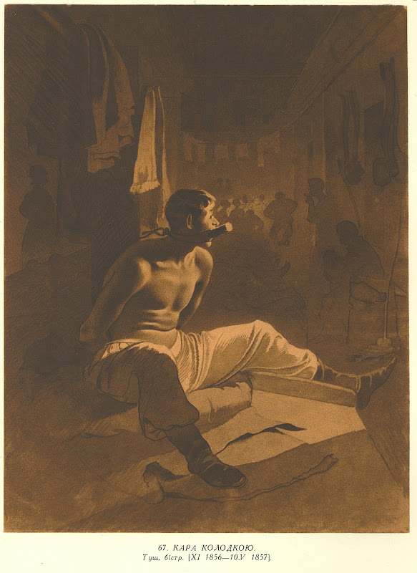
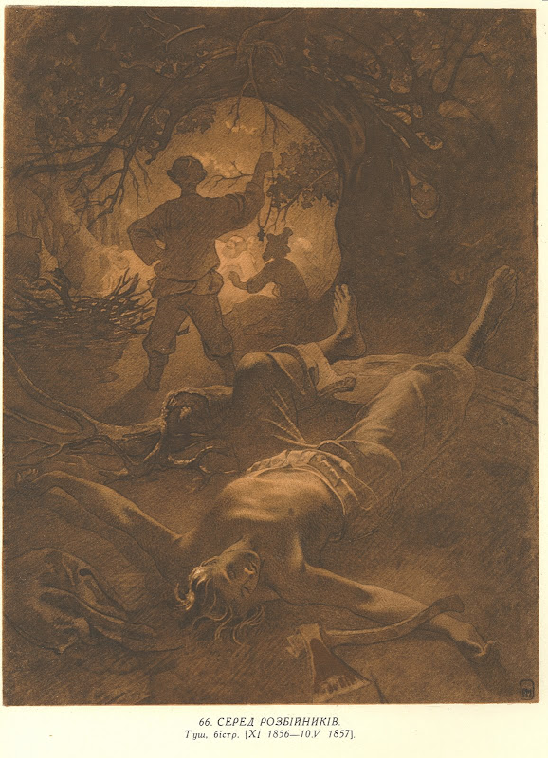

Slide 22
Varnak, summary
1–12 I met an old convict
15–25 Convict says everything is God’s will and mercy
25–35 voice of the poet, keep hope alive, even with tears
36–69 convict’s story, as a young man taken to play with the lord’s children, learned to read and write
55–60 a slave should not know how to read and write
70–96 life as a peasant, met a girl, planned wedding, but the young lordling took her, sent her off as a pokrytka
100–125 I became village scribe, gathered a band and when lordlings held wedding, killed them
140–156 life as a criminal, murdering lords
165–185 convict’s conversion, facing suicide, decides to change and seek judgment for his sins

Slide 23
And then they taught them (51–61)
To be literate. And to my misfortune
I was taught as well.
With tears! With blood!
Thus the learning flowed… Us!
Those cheaper than a lordly dog,
To be granted literacy?!
To pray to God
And behind a plow to stumble,
Nothing more,
Is what the slave should know.
That’s his destiny.

Slide 24
I went mad, and it was hard (157–69)
To live in dens.
I thought of slicing up myself,
To roam the world no longer.
I would have done it,
But to me, a semi-human,
A wonder,
A wondrous wonder happened…
The day was dawning,
And with a knife stashed in my boot
I left the forest in Brovary
To cut myself to death. I look,
And our great sacred Kyiv
Seems to hover in the sky.

Slide 26
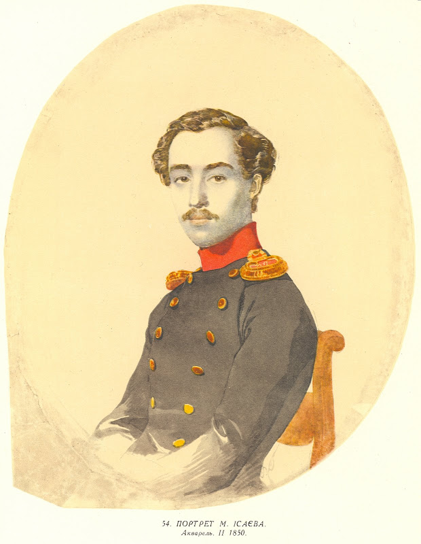
Mykola Hryhorovych Isaev
ensign line battalion No. 3 of the Orenburg separate unit corps,
Ukrainian, son of Poltava doctor. Shevchenko paints portrait
After Aral Sea expedition, Shevchenko lives like a free man
Shevchenko living in home of Karl Gern, topographer on expedition
Isaev is courting Herne’s wife. Shevchenko discovers it
Shevchenko tells Herne and helps him throw Isaev out of the home
Isaev writes a denunciation of Shevchenko, that he’s painting, writing
Shevchenko’s attempts at promotion and release are ruined

Slide 27
Letter to Ya. Kucharenko, April 22, 1857, on learning of release
А журнала уже десятий рік і в очі ні одного не бачив і не знаю, що там і діється в тій новій, чи современній, літературі. Сам не написав нічого, бо мені було заказано писать. А тепер уже і Бог його святий знає, чи й напишу що-небудь путнє. Я ще не дуже зостарівся, та знівечився, друже мій єдиний. А може, дасть Господь милосердний, ще одпочину та на старість попробую писать прозу. О віршах уже нічого й думать.
As for journals, I haven’t seen one in ten years and I have no idea what is going on in the new, contemporary literature. I have not written anything myself, because I was forbidden to write. And now, God alone knows whether I can write anything sensible. I’m not really old yet, but I am wasted, blighted, my dear friend. Merciful Lord willing, maybe I can get some rest and try my hand at prose in my old age. As for poems, there’s no chance of that.

Slide 28
Letter to Ya. Kucharenko, June 5, 1857, six weeks later
Постриг ти мене в брехуни своїм братерським листом і своєю щирою писанкою. Я писав тобі, друже мій єдиний, що вже не втну нічого віршами. Отже і збрехав. Збрехав і не схаменувся. Правда, я сам думав, що я вже зледащів, захолонув в неволі. Аж бачу — ні. Нікому тілько було огню положить під моє горем недобите старе серце. А ти, друже мій, догадався, взяв та й підкинув того святого огню. … Що тут на світі робить? — думаю собі, та, вставши раненько, помолився Богу, закачав рукава та й заходився коло оції «Москалевої криниці». Бог поміг, то сяк, то так кончив.
You made a liar of me with your friendly letter and gift. I had written to you saying I couldn’t write poetry any more. But I lied. I told a lie and took stock of myself. Sure, I had thought I was become useless and without creative power here in prison. But no! Someone needed to add fire to my worr-wracked heart. And you did that. … What’s for me to do in this world, I thought. I got up early one moring, prayed to God, rolled up my sleeves and sat down to this poem, “The Soldier’s Well.” With God’s help, for better or worse, it’s finished.

Slide 29
Moskaleva 2. 1857
Intro, Varnak, crumpled, squeezed together this stolen poem for you, Kucharenko
Moskal had dug the well, story of widow and daughter
The orphan (Maxim) who made good and married Kateryna
Convict, jealous of Maxim, had himself proposed earlier, burns down Maxim’s house
Kateryna died. Maxim is hired hand again, the widow’s son is put up for conscription
Russo-Turkish war of 1787–1792, 1775, destruction of Zaporizhzhia, Ochakiv 1788
Maxim is injured, lost a leg, returns, powders his wig, reads in church, and I killed him
You saw the well, but no one told you the story. I still suffer. Maxim was a man of God, and he dug a well for the community
Why did I want to kill him, why did Cain kill Abel? I call Maxim Ulasovych to come to the well with me, where I threw him down into it, like a cursed devil.
A week later people pulled out his corpse, and I became a Haidamaka, ended up in Siberia.

Slide 30
Not in Ukraine, but faraway (1–11)
Past the Urals, past the Ilek River
A surviving branded convict
Told me this about a well,
A well dug by a soldier.
And being sad I wrote it down,
Adding just a bit of rhythm,
To scrawl a cheap and trifling poem
(Plagiarized, of course)
In remembrance of you,
My earnest friend, my only!

Slide 31
Neither punishments, (55–64)
My son, nor torture,
Shackles nor the years,
Have exhausted all those strengths…
And so I’ll die!
Thus I’ll perish. Because look:
Death is something I expect,
But I cry much like a child,
When I recall Kateryna.

Slide 32
And I went with the haidamaks, (399–407)
And landed in Siberia.
(For this was once Siberia.)
And here I perish, like a dog,
Like Judas! Pray for me to God,
My son, in our most glorious Ukraine,
In that happy, happy land.
Won’t my burden ease?

Slide 33
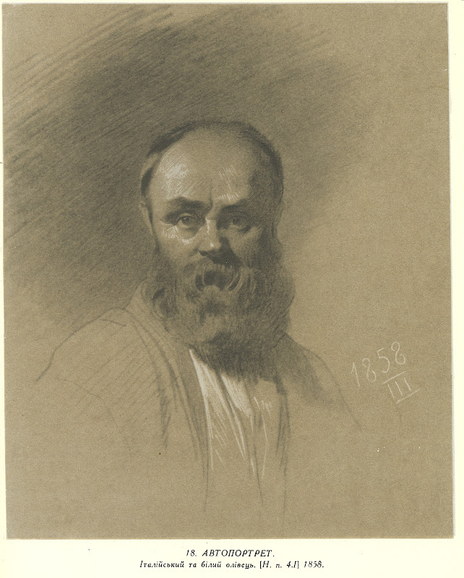
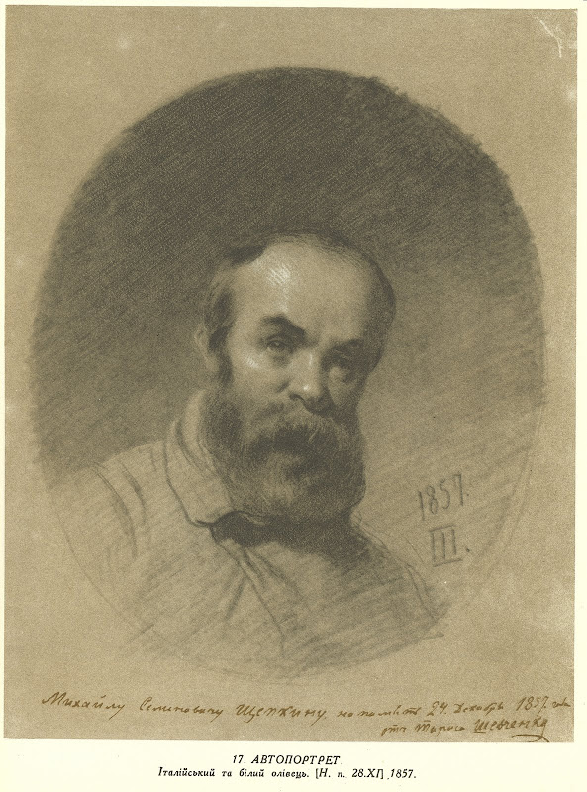

Slide 34
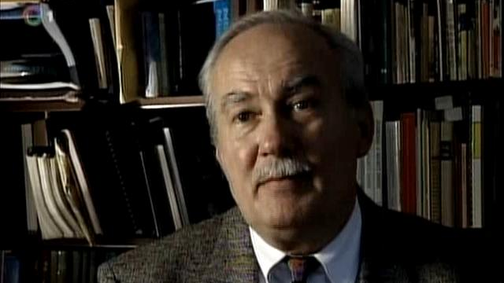
Thank you

